Slide 1
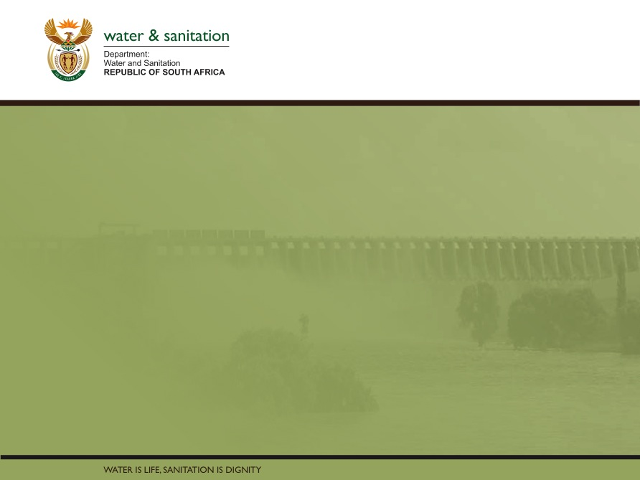
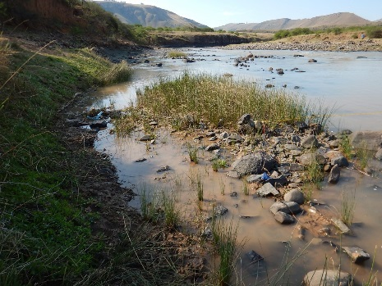
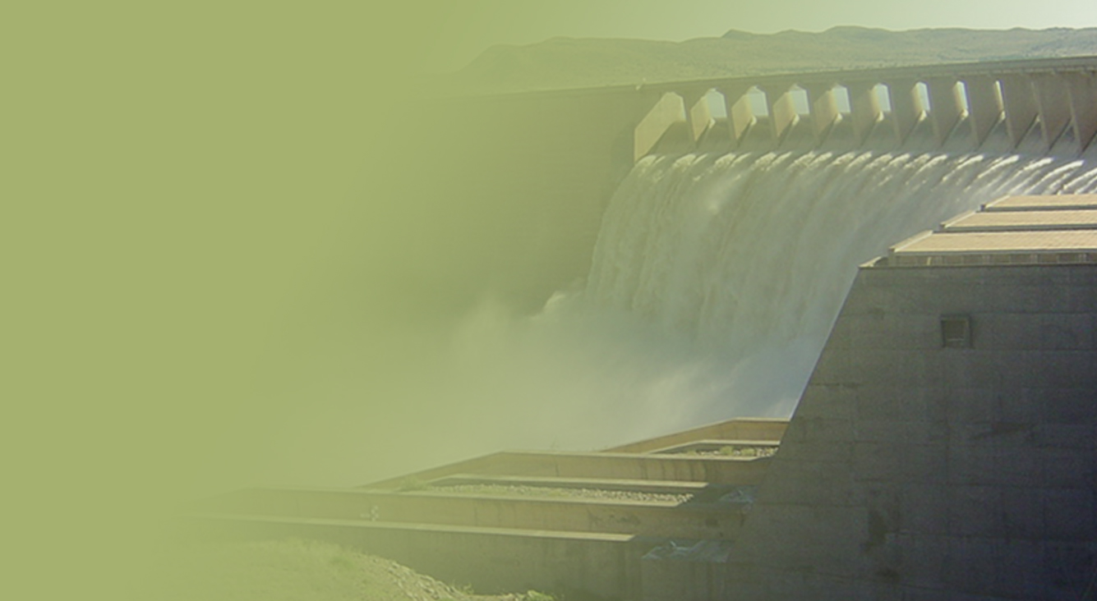
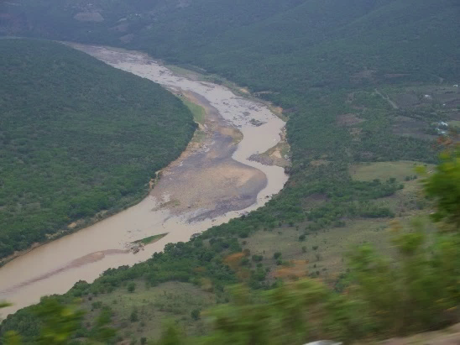
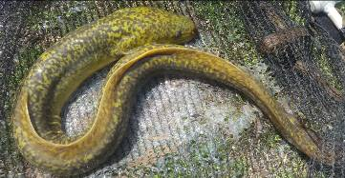
WP 11004: PSC MEETING 3,
13 February 2018
PRESENTATION TITLE
Presented by:
Name Surname
Directorate
Date
DETERMINATION OF WATER RESOURCE CLASSES AND RESOURCE QUALITY OBJECTIVES FOR THE WATER RESOURCES IN THE MZIMVUBU CATCHMENT:
MODELLING OF OPERATIONAL SCENARIOS – PHASE 2
Colin Talanda

Slide 2
PROJECT PLAN

Slide 3
INTRODUCTION
Key to WRCS is balancing protection of ecology and use of water to sustain the desired socio-economic activities dependant on water resources
Operational scenarios are based on flow and water quality related aspects and not on non-flow related aspects (managed through the RQO process)

Slide 4
IDENTIFICATION OF OPERATIONAL SCENARIOS
Scenarios identified from ongoing Municipal and DWS planning processes (discussions and reports)
Identified Scenarios confirmed with stakeholders
Information included but not limited to:
  DWAF 2009 Water Resource Study in support of the AsgiSA EC Mzimvubu Development Project
  DWS 2014 Feasibility Study for the Mzimvubu Water Project
  DWS 2015 Development of Reconciliation Strategies for All Towns in the Southern Planning Region
  Heritage Impact Assessment of Ugie Storage and Supply Dam (2010)
  Umzimvubu and Matatiele Regional Bulk Water Supply Study (2013)
  Alfred Nzo Regional Bulk Water Supply Assessments (2013)
  Ntsonyeni Ngqongweni Regional Water Supply Scheme Phase 2 and 3 (2015)

Slide 5
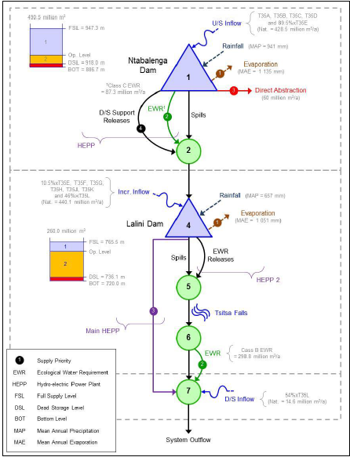
IDENTIFICATION OF OPERATIONAL SCENARIOS
Additional scenarios analysed (October 2017) - latest MWP design information and optimised hydropower operating rules from design team (Pro-Plan)
Hydropower operating rules are significantly different to previous scenarios, which influences flows at the downstream EWR sites:
      Previous (2014 Feasibility Phase): Lalini Dam drawn down continuously and supported by Ntabelanga when the water levels reached the Dead Storage Level i.e. water is kept in Ntabelanga
      Pro-Plan (2017 Design Phase): Lalini operated to stay +-75% nett storage i.e. when the dam level <=+-75% nett storage, support is provided from Ntabelanda Dam up to a minimum level to avoid failure i.e. Lalini Dam 'kept full' for maximum head.

Slide 6
OPERATIONAL SCENARIOS EVALUATED
Scenarios are presented for the main river systems that are influenced by operational activities.
Scenarios set up and analysed using the Water Resources Yield Model (WRYM).
Summary of PES and REC results for EWR sites (this study):

Slide 7
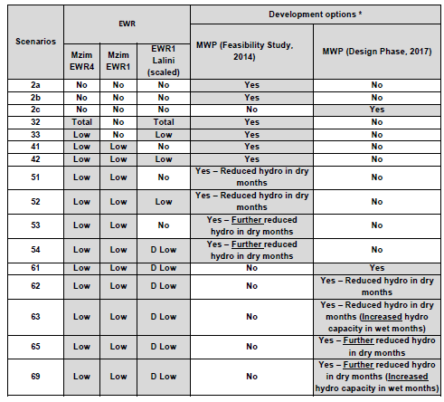
SUMMARY OF SCENARIOS
All scenarios include updated water demands to 2040 (ultimate projection; but Sc 2a = realistic).
* Development options common to all scenarios:
1. Revive irrigation (T33A-T33G).
2. New municipal dams / abstractions

Slide 8
Sc 61
EWRs and hydro
Sc 62
EWRs and hydro decreased in dry months
Sc 63
EWRs and hydro decreased in dry months and increased in wet month
Sc 65
EWRs and hydro further decreased in dry months
Sc 69
EWRs and hydro further decreased in dry months and increased in wet month
FLOW-CHART OF SCENARIO DEVELOPMENT
Sc 70
Same as 69 but with no EWR from Lalini

Slide 9
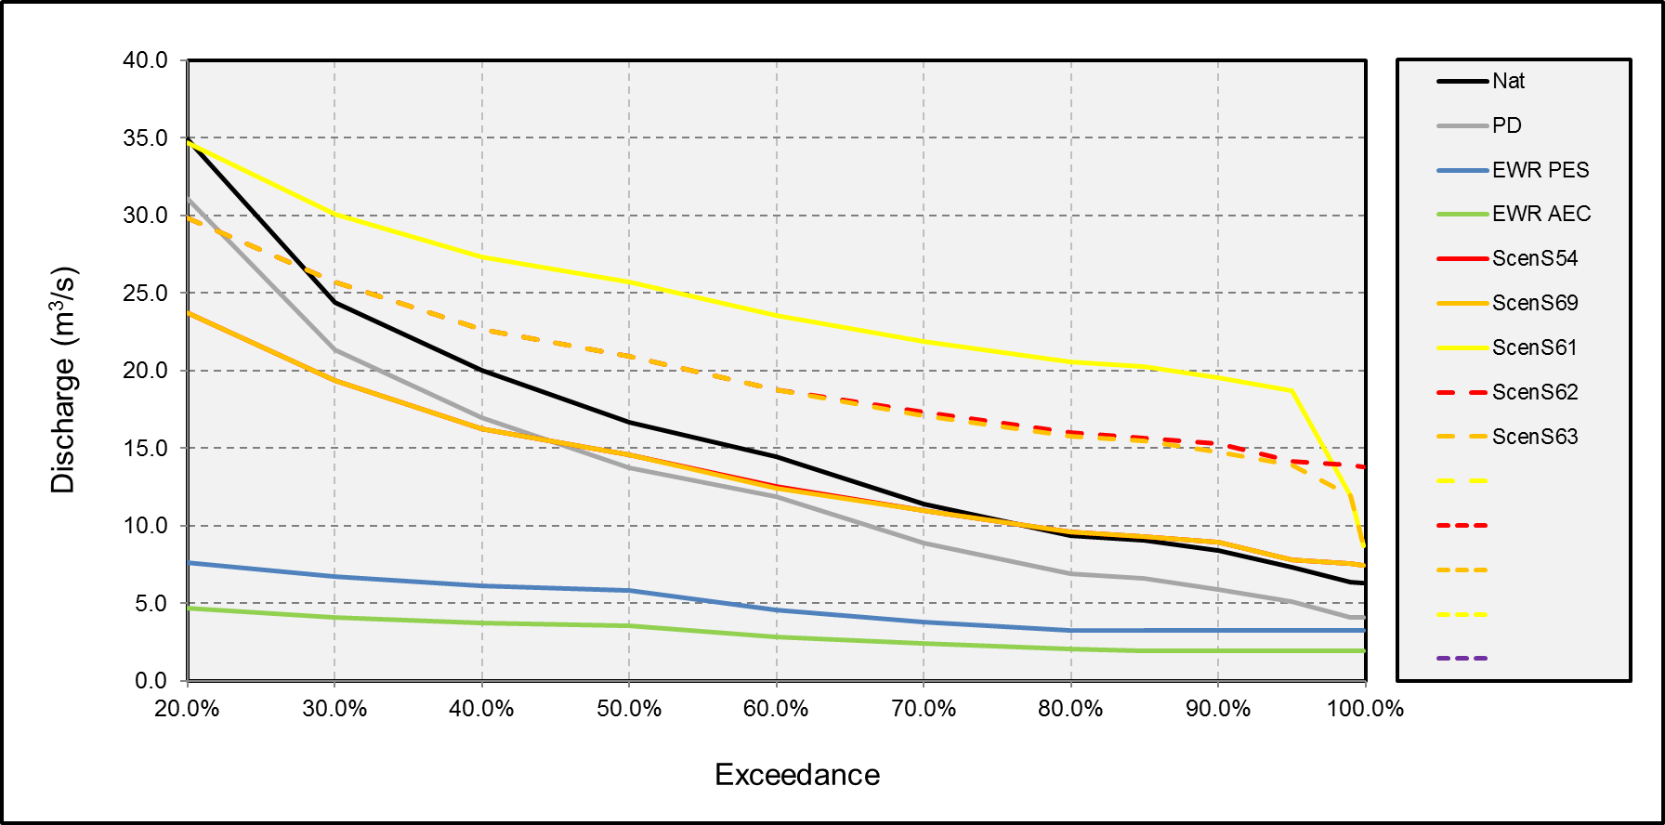
DEMONSTRATION OF THE ‘TOO MUCH FLOW’ SITUATION

Slide 10
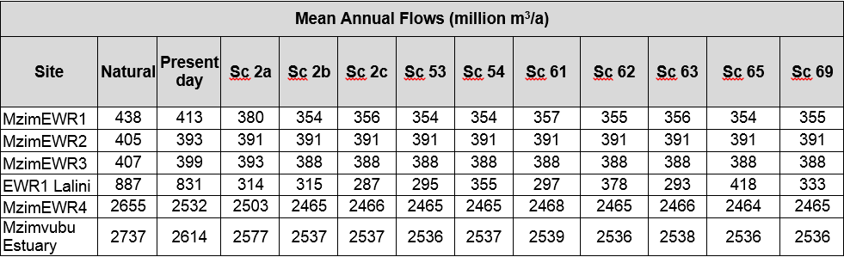
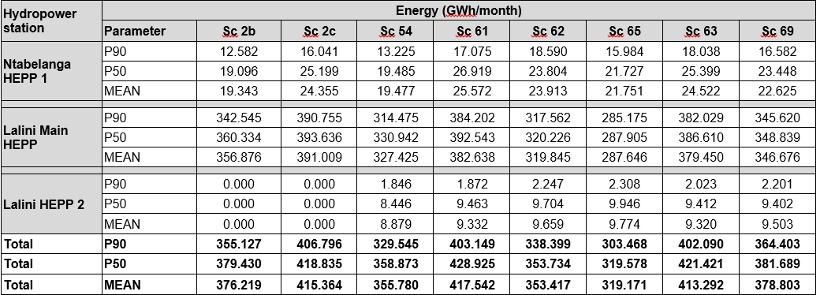
SCENARIO RESULTS

Slide 11
SCENARIO ENERGY RESULTS

Slide 12
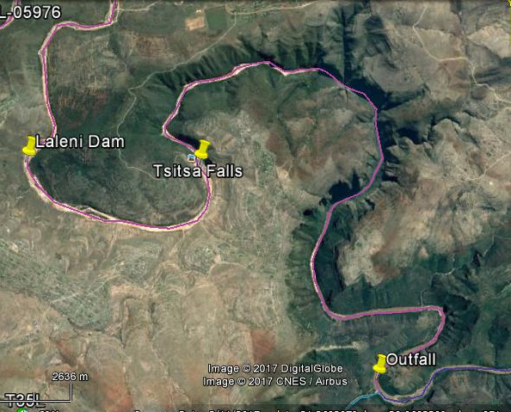
SC 70: DOWNSTREAM LALINI DAM
Lalini Dam
Tsitsa Falls
4.8 km
13.5 km
Outfall

Slide 13
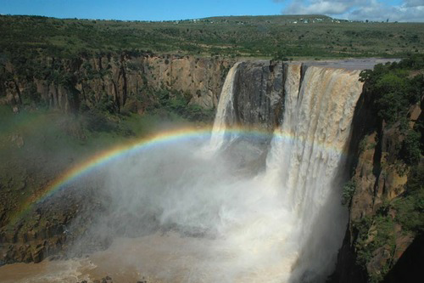
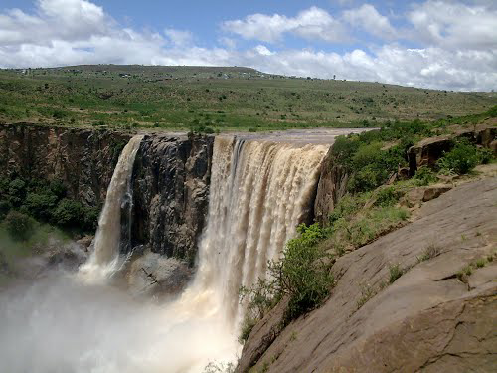
TSITSA FALLS

Slide 14
SC 70: DOWNSTREAM EWR1 LALINI
EWR releases to maintain the REC was part of the Pro-Plan operation.
Initial thinking was that this may minimise flow available for power generation for a short isolated stretch of river. Therefore, a nominal flow based on an extrapolated D was included. The main aim was to have water over the falls rather than the ecology.
Once the Pro-Plan info became available, it was noted that a small hydropower station at the river was planned to utilise the EWR release for power generation.
Not having any flow (Sc 2b, 2c, 53 and 70) would result in an infrastructure cost saving. It would not impact on power generation – therefore economic evaluation of 70 not required.
Possible that the D flows are too small to warrant power station and that flows should be increased to the REC (C).
This optimisation must be done by the designers. From an ecological point of view, increased flows would be good as long as the balance of flows below the outlet are the same as for Sc 53, 54 and 69.

Slide 15
SUMMARY AND CONCLUSIONS (1)
Scenarios 2c and 61–69: Based on latest MWP infrastructure design info (2017 Design Phase).
Initial assessments showed a large increase in dry winter month baseflows (hydropower releases) which was unacceptable ecologically.
Reduction scenarios were iteratively analysed until an ecologically acceptable scenario was identified (i.e. Scenario 54 and Scenario 69).

Slide 16
SUMMARY AND CONCLUSIONS (2)
Many iterative scenarios were analysed and it is recommended that only the following scenarios are considered during decision-making and selection of the final scenario and associated Classes: Scenarios 2b, 2c, 54, 61, 62, 63, 65, 69 & 70.
The outcome of the decision analysis (recommended scenario) should be analysed and incorporated into the MWP infrastructure final design.
The MWP catchment should be carefully monitored and controlled and upstream development should be limited as this will impact negatively on the economics of the scheme.

Slide 17
QUESTIONS FOR CLARIFICATION

